Slide 1
Project II and III

Slide 2
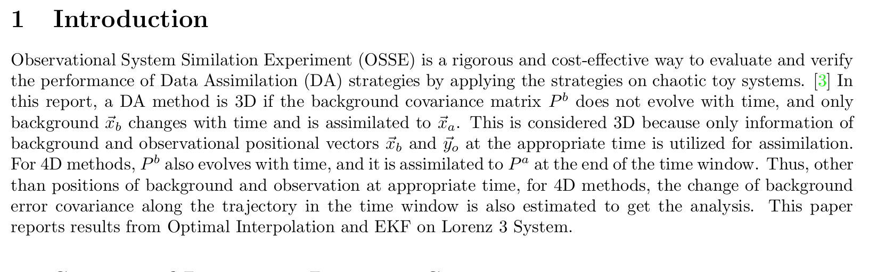
3D : only positional vector from the appropriate time is considered
4D: information about how background change with time is used to update Pb.

Slide 3
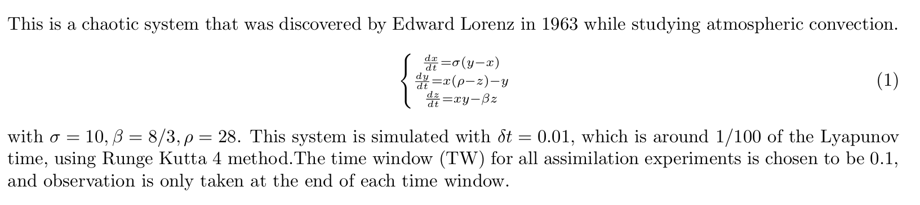
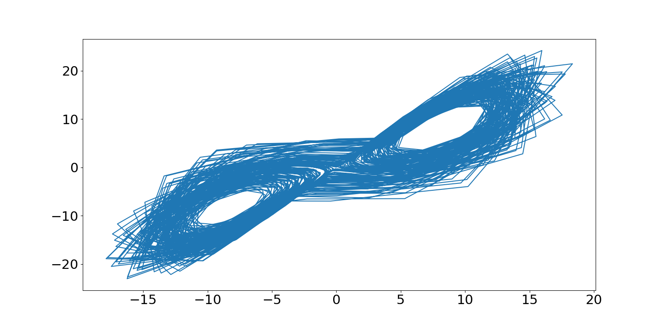
Lorenz system

Slide 4
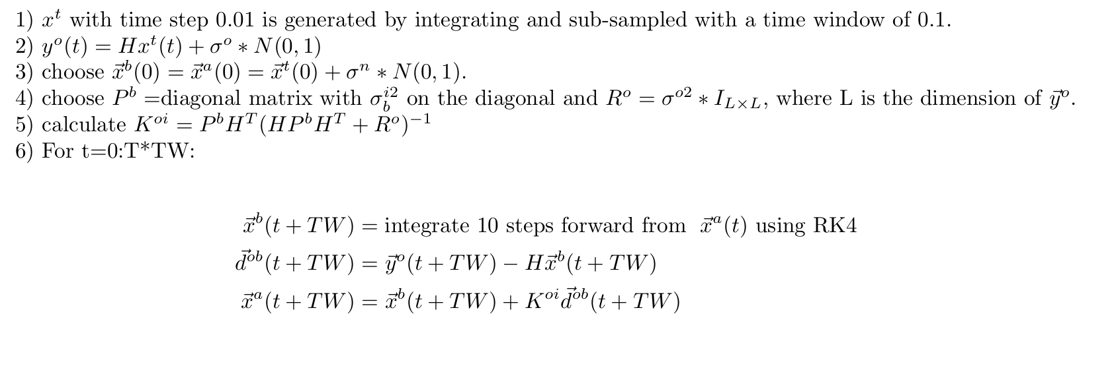
OI algorithms: P^b is fixed and prescribed

Slide 5
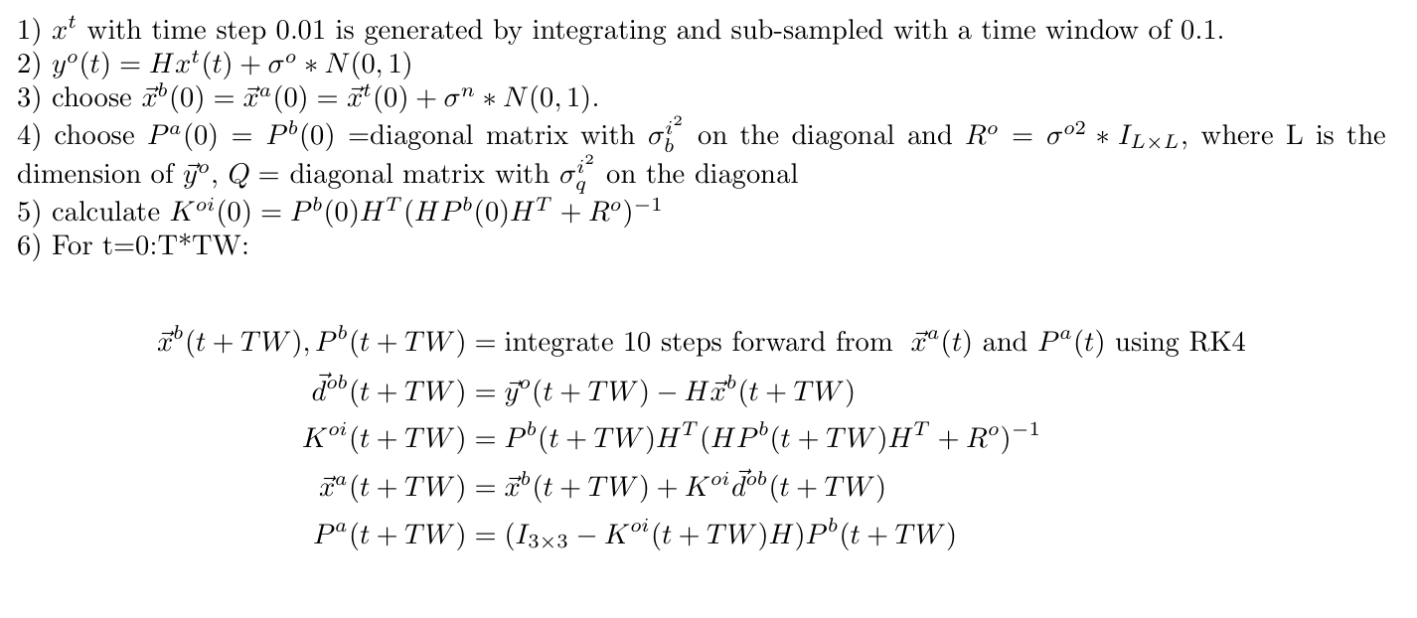
EKF : similar to OI, but P^b is evolving with tangent linear model approximation

Slide 6
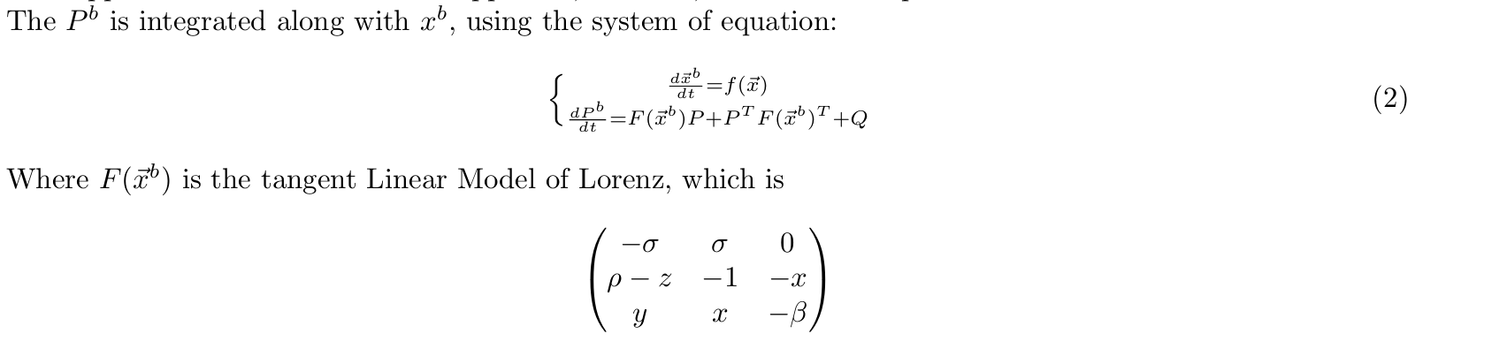
Inflation of Pb
I chose to inflate Pb by adding the Q matrix in integration

Slide 7
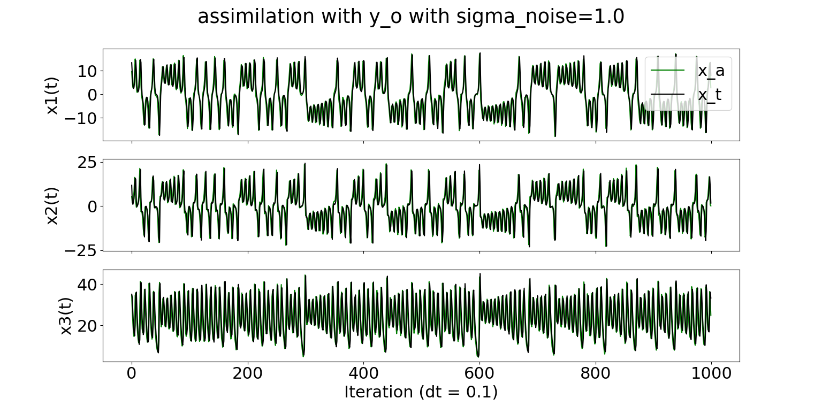
Results : OI (fully observed) MSE=0.4209 (initial perturbation sigma_n ~ 3*N(0,1)

Slide 8
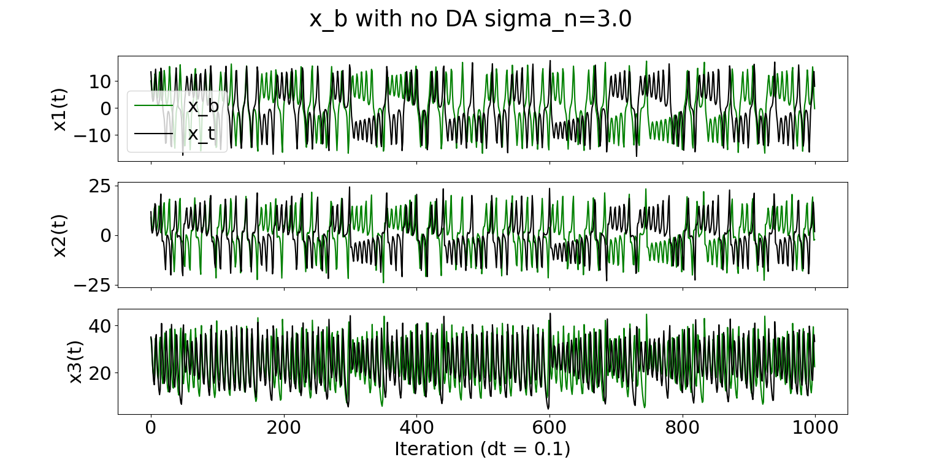
x_b with no DA : Quickly deviates from truth

Slide 9
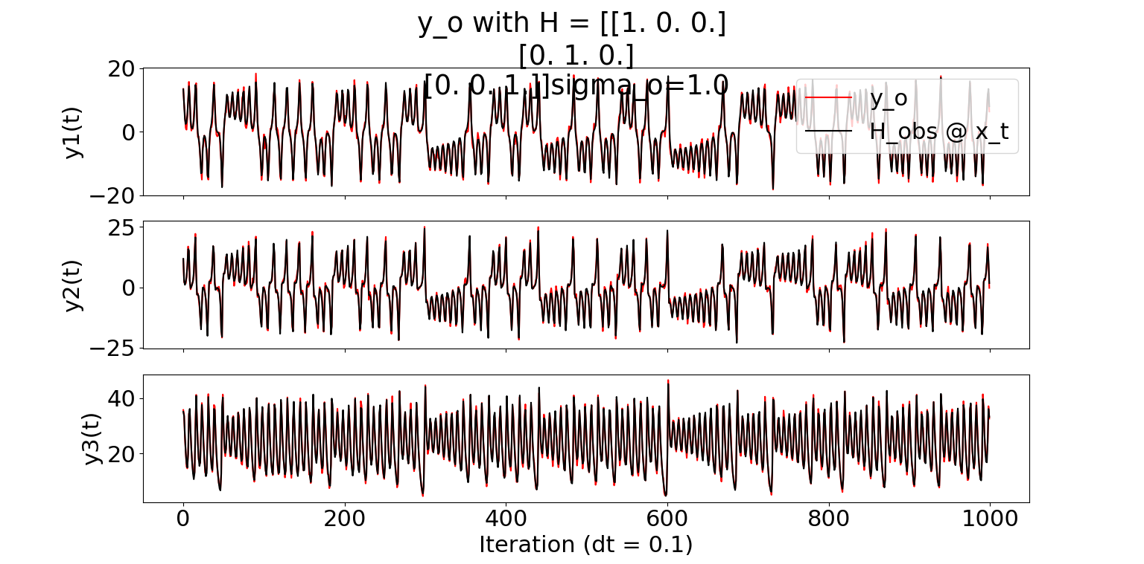
Observation : with observational noise ~ N(0,1)

Slide 10
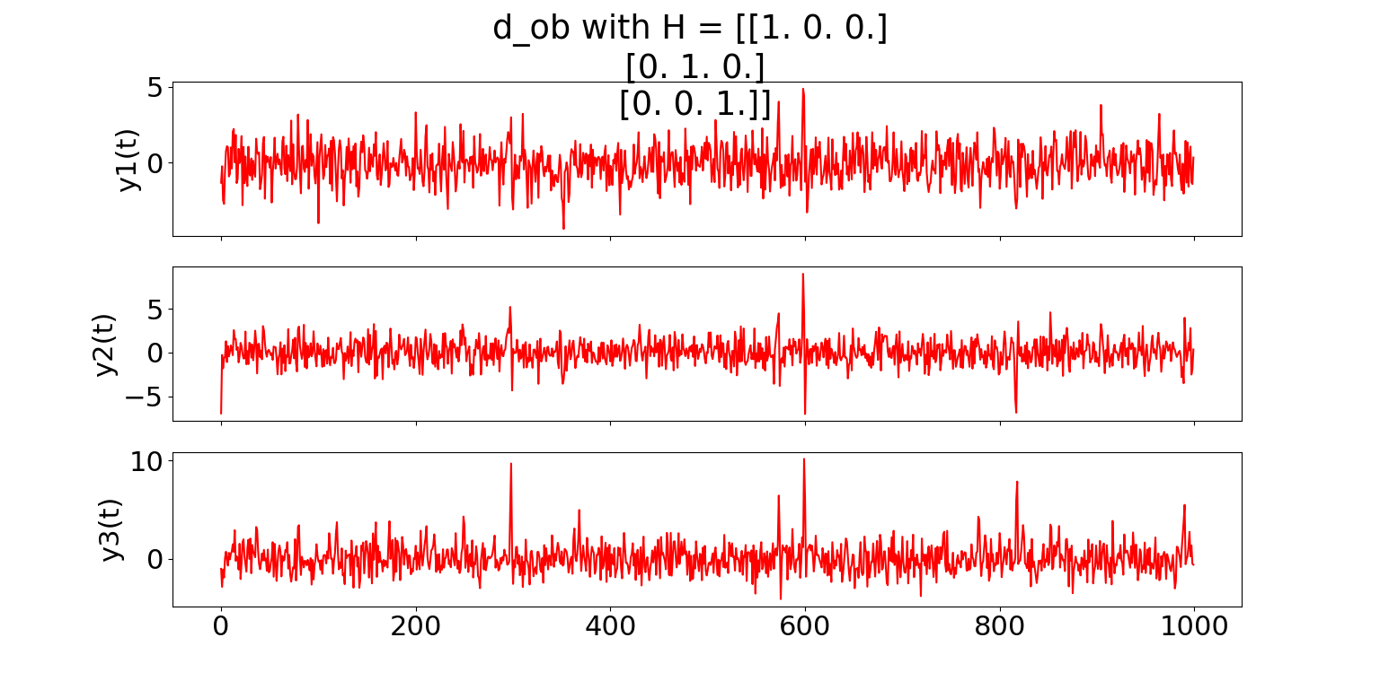
d_ob

Slide 11
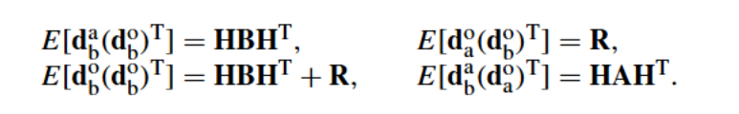
Correlation matrices compare: from Desroziers et al.

Slide 12
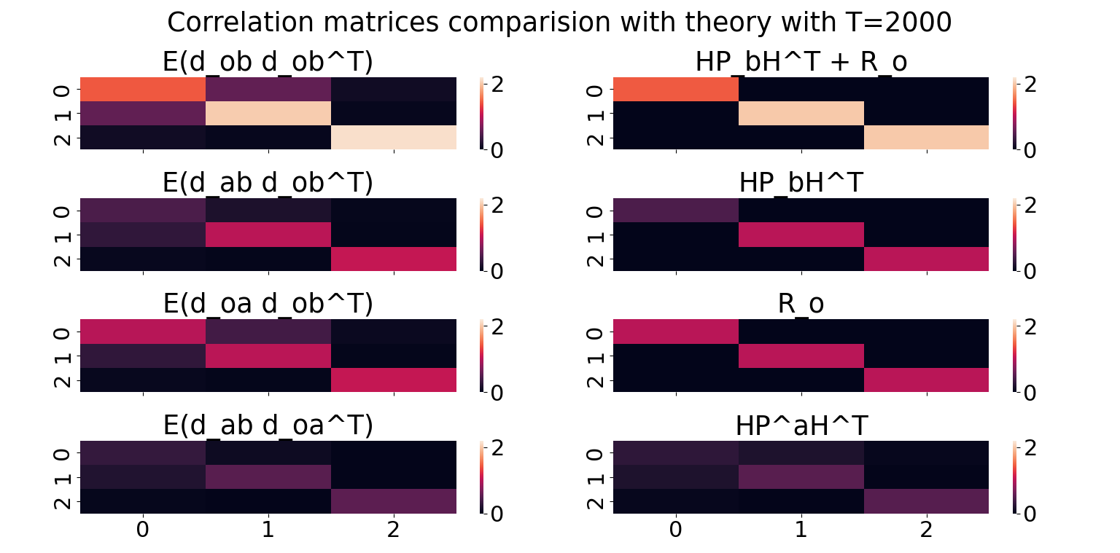

Slide 13

OI : Not observing Z (MSE=0.6011)

Slide 14
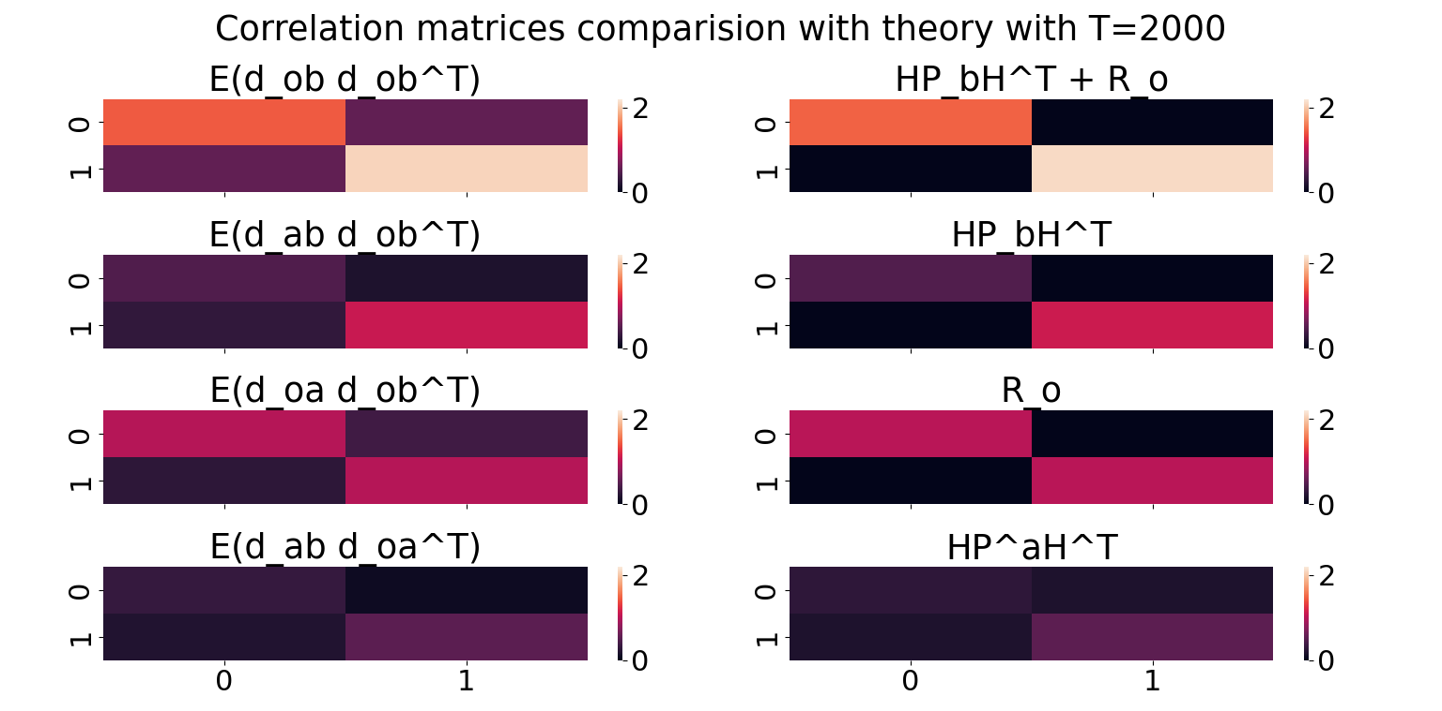

Slide 15
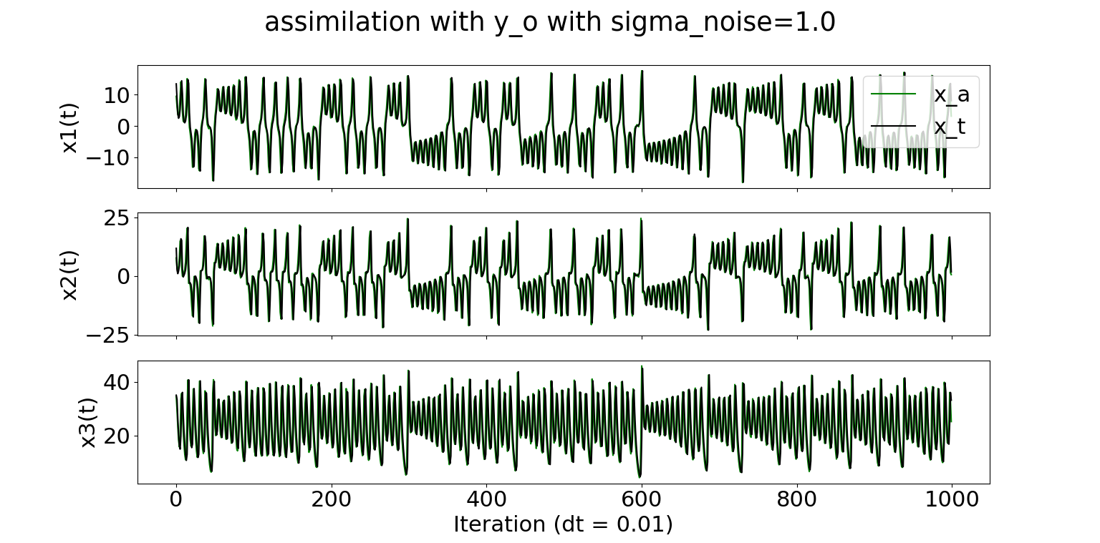
EKF results: fully observed (MSE=0.1260)

Slide 16
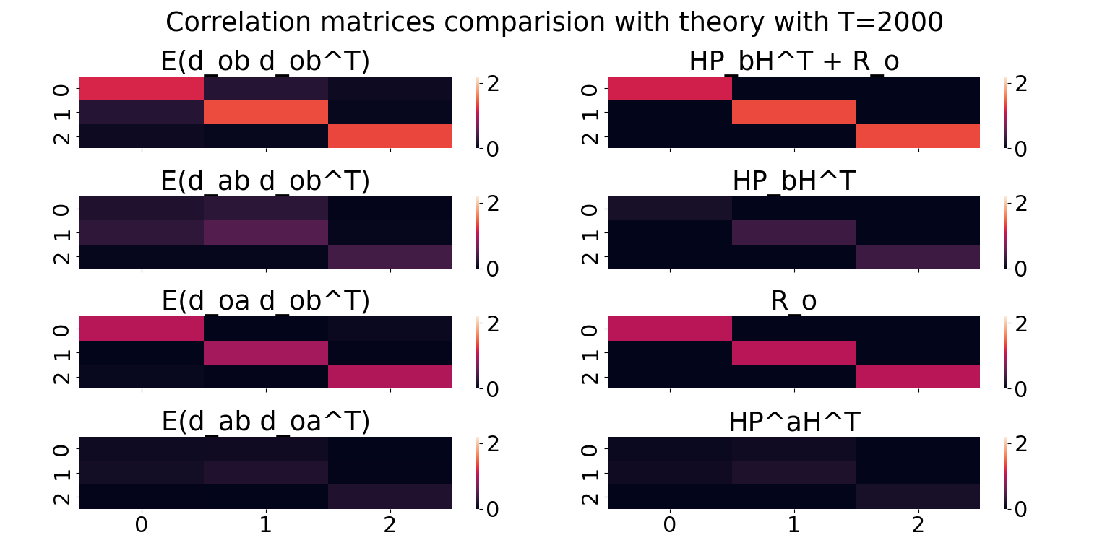
The P_b used here is P_b(0) I tuned both P_b(0) and Q

Slide 17

EKF results: Z is not observed (MSE=0.2125)

Slide 18
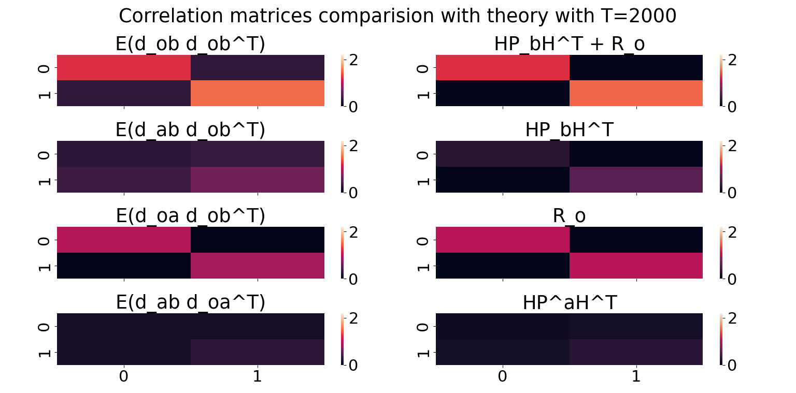
EKF results : Z is not observed

Slide 19
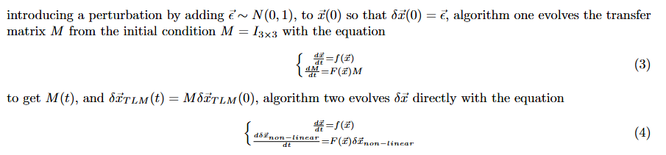
Validating the Tangent Linear Model

Slide 20
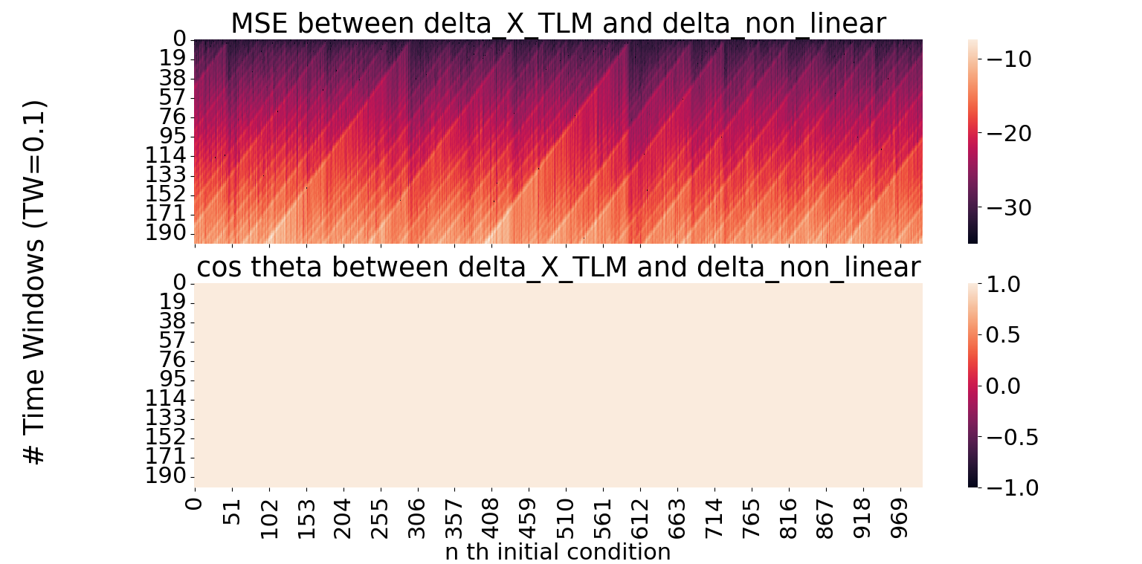
Over 1000 initial conditions : ergodicity is reached

Slide 21
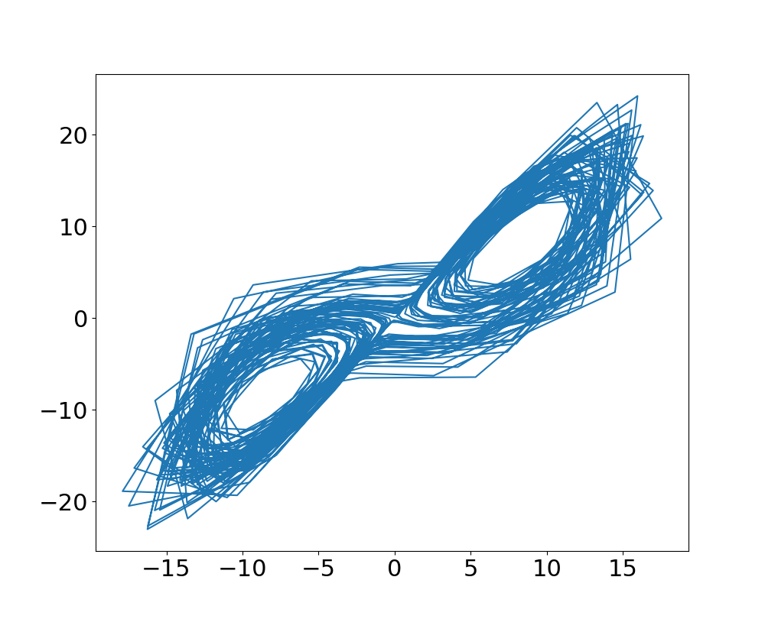

Slide 22
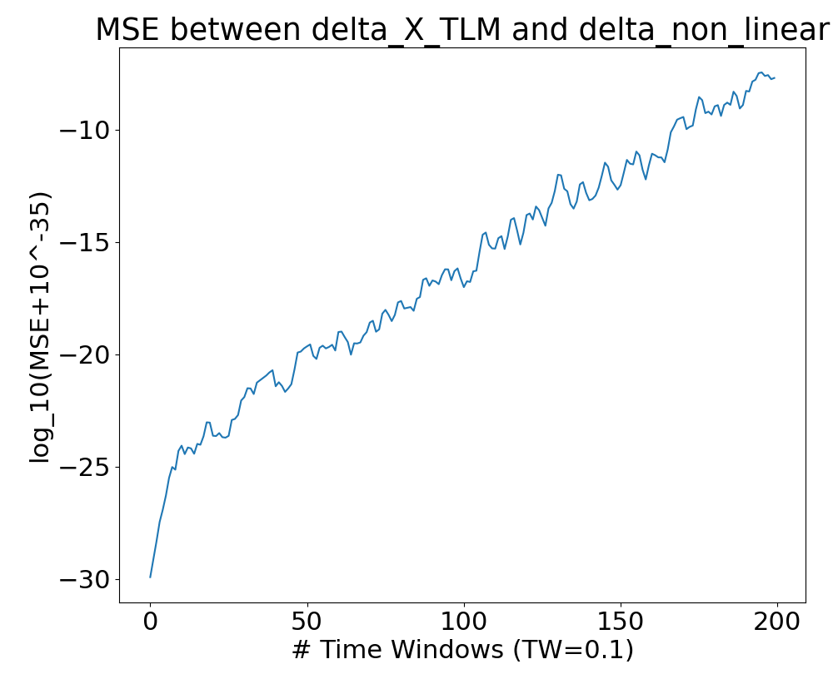
The 10^-35 in the beginning is artificial
MSE growing exponentially with number of time windows

Slide 23
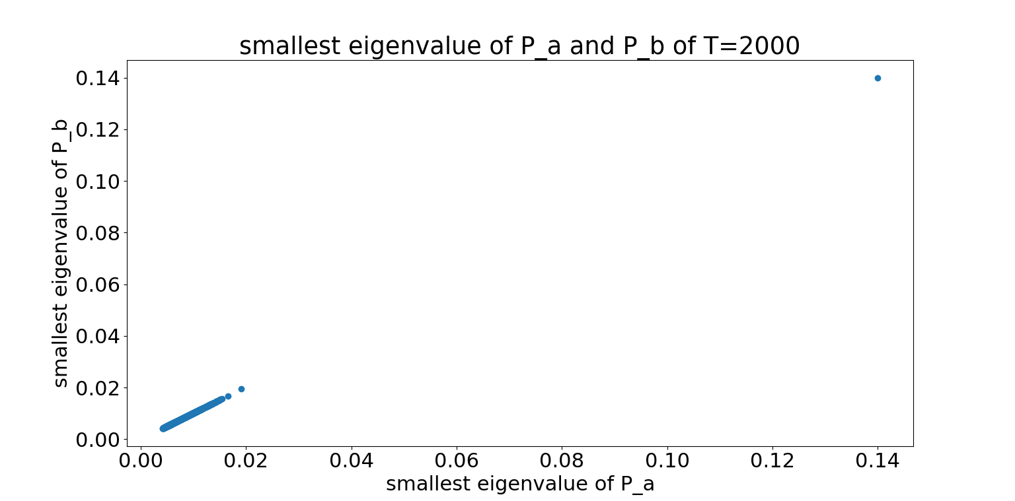
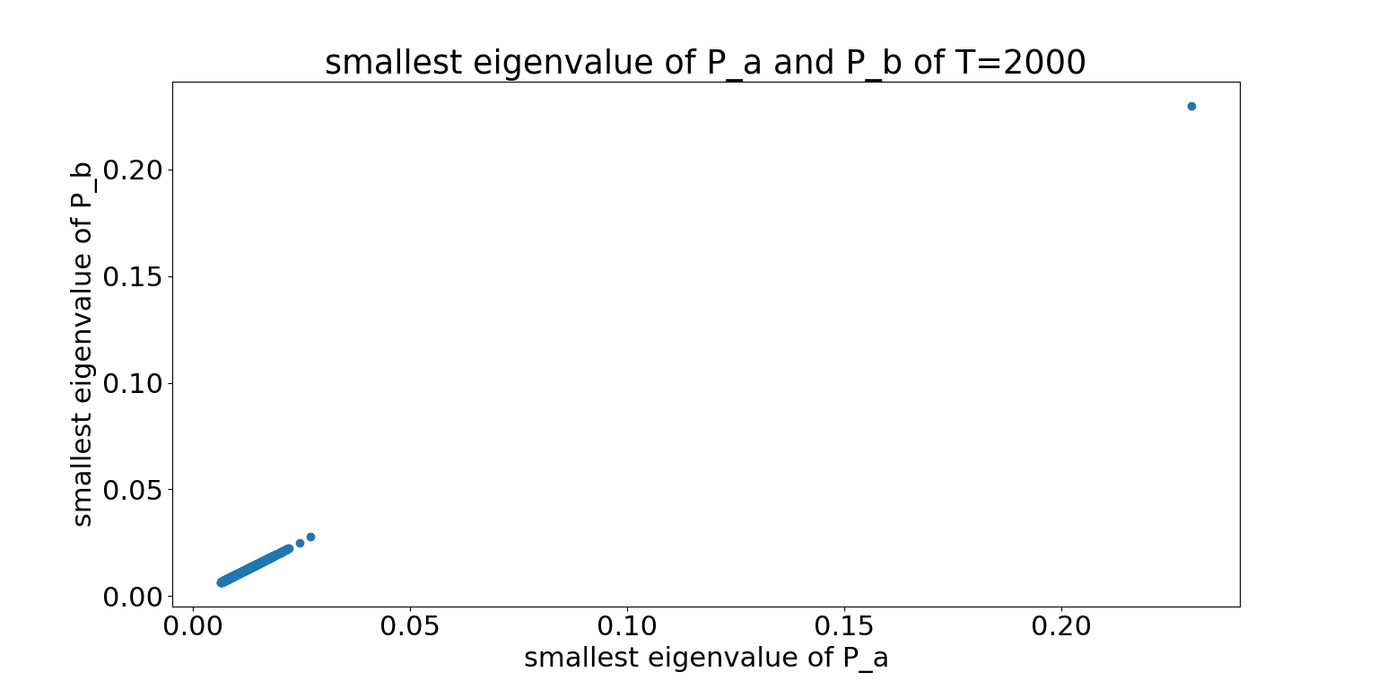
Is Pa and Pb positive definite and symmetric?
Fully observed
All eigenvalues of Pa and Pb are positive!
Only x and y observed

Slide 24
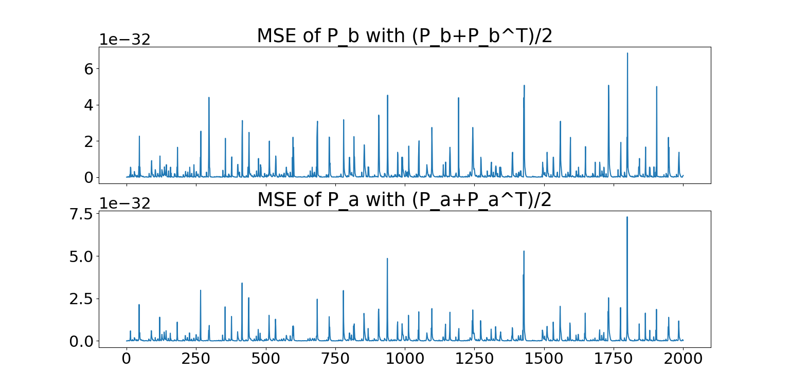
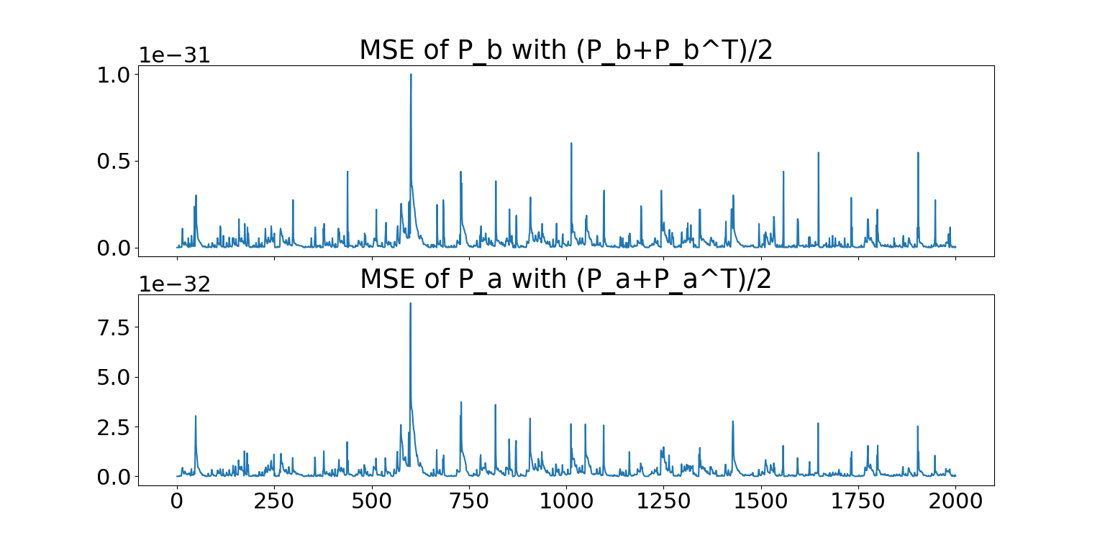
Effectively 0
Fully observed
Only x and y observed

Slide 25
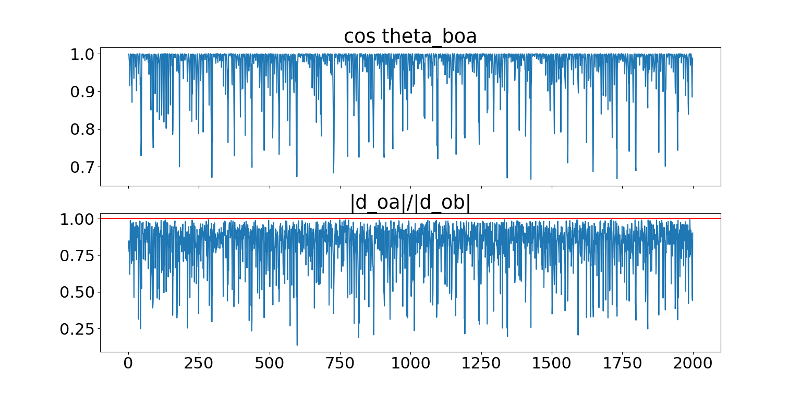
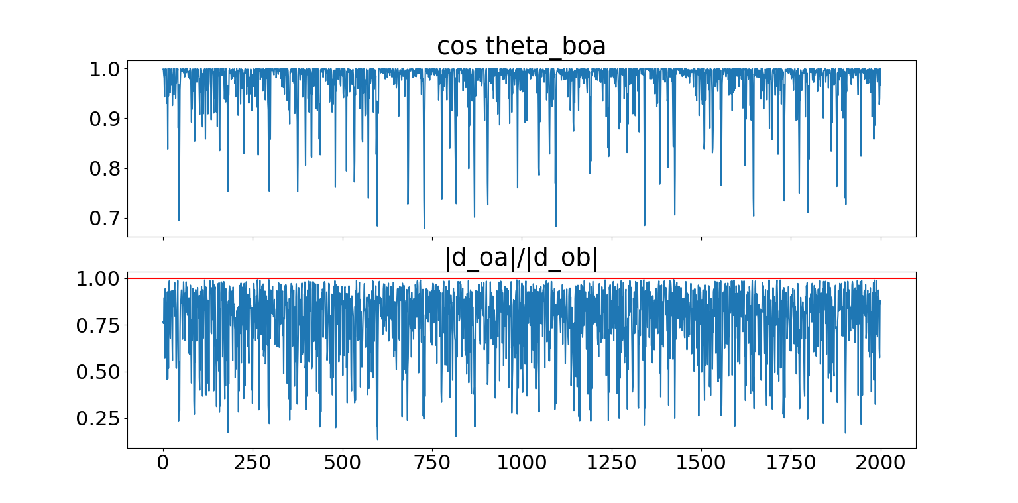
Cos angle and ratio of magnitude of dob and doa
Fully observed
Only x and y observed

Slide 26
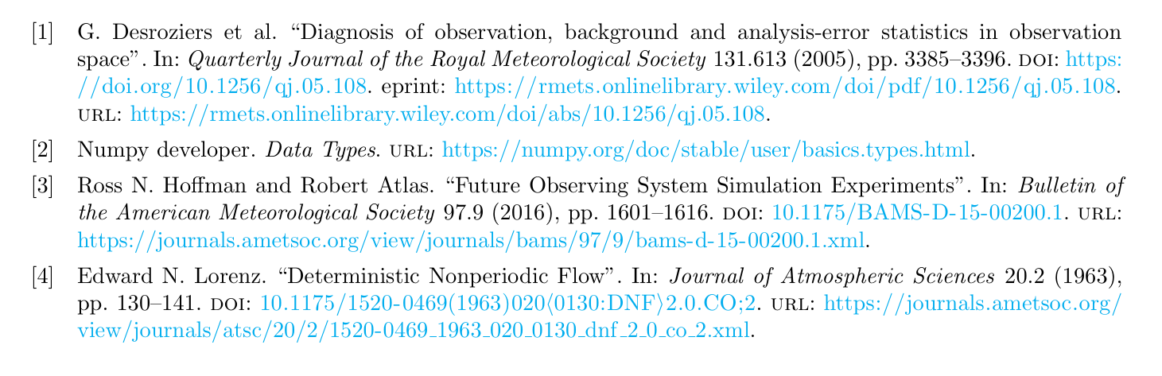
Reference

